Slide 1
Graph Structural Features lecture-3 Course on Graph Neural Networks (Summer Term 22)
Prof. Dr. Holger Giese (holger.giese@hpi.uni-potsdam.de)
Christian Medeiros Adriano (christian.adriano@hpi.de) - “Chris”
Matthias Barkowsky (matthias.barkowsky@hpi.de )
Iqra Zafar (iqra.zafar@hpi.de)

Slide 2
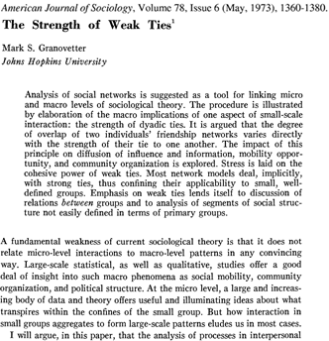
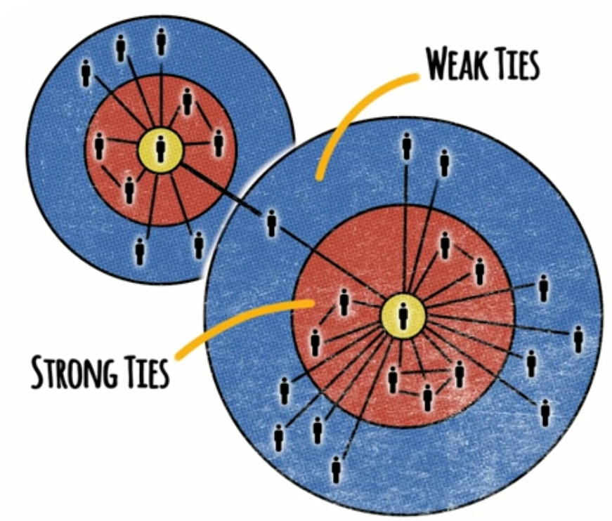
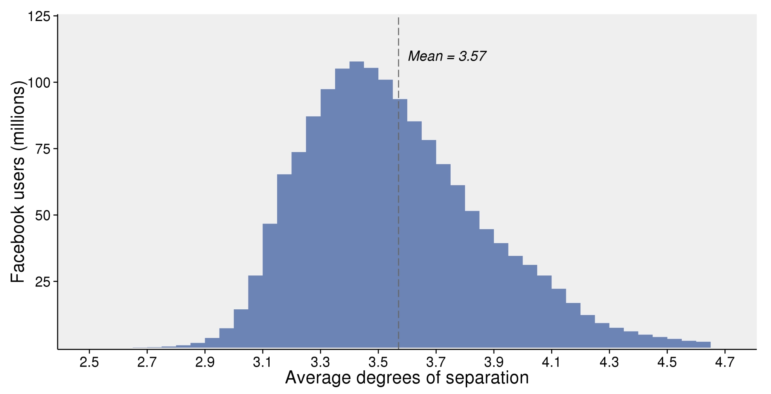

The Strength of Weak Ties [Granovetter 73]
Interesting facts:
Most people change jobs voluntarily
56% found new jobs through personal contacts
3/4 of the highest income categories
More difficult to change if>5 years in a job
People with 2 to 5 years in a job were more likely to find jobs through weak ties
source: Interview with Mark Granovetter at Stanford - https://www.youtube.com/watch?v=g3bBajcR5fE&pbjreload=101
A
Why?
B
C
D
Instant global communication
Triads tend to form -> increasing the spread of information within a cluster
Figure 1. Estimated average degrees of separation between all people on Facebook.
Shrinking average shortest paths
JJ Ying https://unsplash.com/photos/8bghKxNU1j0
https://research.fb.com/blog/2016/02/three-and-a-half-degrees-of-separation/
Notes:
Acquaintances connect us to other groups, so in a sense, they are our windows to the world.
Most people change jobs voluntarily, so they are looking for information that helps them make decisions, e.g., how is to work there? What about the tasks, the colleagues, the management, etc.
56% found new jobs through personal contacts
3/4 of the highest income categories (this effect was stronger in the top earners)
Difficult to change jobs for those who were >5 years
Average job to 2 to 5 years, were more likely to find jobs through weak ties
Strength of connections leads to clusters
Sources:
https://www.youtube.com/watch?v=g3bBajcR5fE&pbjreload=101
https://research.fb.com/blog/2016/02/three-and-a-half-degrees-of-separation/
JJ Ying https://unsplash.com/photos/8bghKxNU1j0

Slide 3
Lecture topics
Structure of Graph
Motifs – the building blocks
Graphlets – the landscape
Metrics
Centrality metrics
Structural membership metrics
Homophily metrics (Assortativity and Neighborhood)
2. Clustering
Community detection
Spectral clustering

Slide 4
Network metrics
Network-level metrics
Average node degree (degree distribution)
Average clustering
Average path length (diameter)
Node connectivity (distribution among components)
Node-level metrics
Centrality (degree-based): Katz, PageRank
Centrality (path-based): closeness and betweenness
Pair-wise metrics
Edge-overlap
Node equivalence (Regular and Structural)
Node similarity

Slide 5
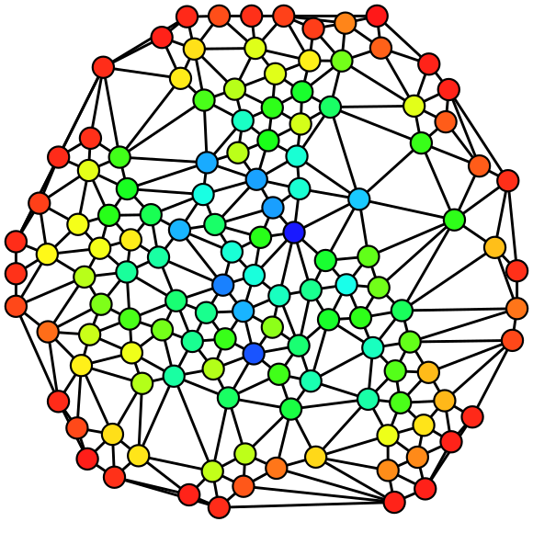
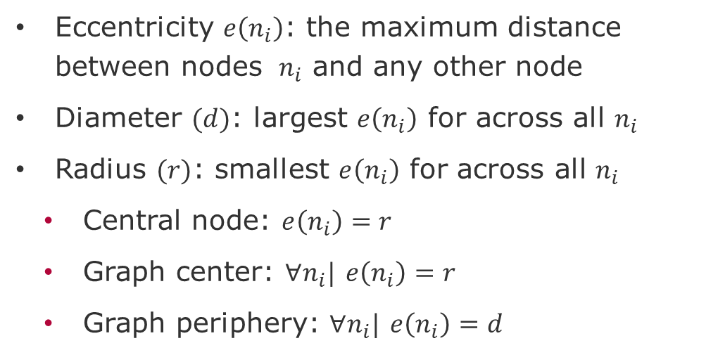
Graph theoretic measures
Eccentricity $e\left(n_{i}\right)$: the maximum distance between nodes $n_{i}$ and any other node
Diameter $(d)$: largest $e\left(n_{i}\right)$ for across all $n_{i}$
Radius $(r)$: smallest $e\left(n_{i}\right)$ for across all $n_{i}$
Central node: $e\left(n_{i}\right)=r$
Graph center: $∀n_{i}|$ $e\left(n_{i}\right)=r$
Graph periphery: $∀n_{i}|$ $e\left(n_{i}\right)=d$
source: Wikipedia

Slide 6
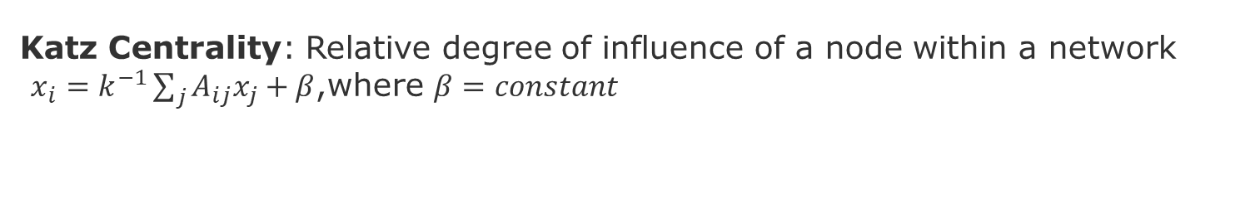
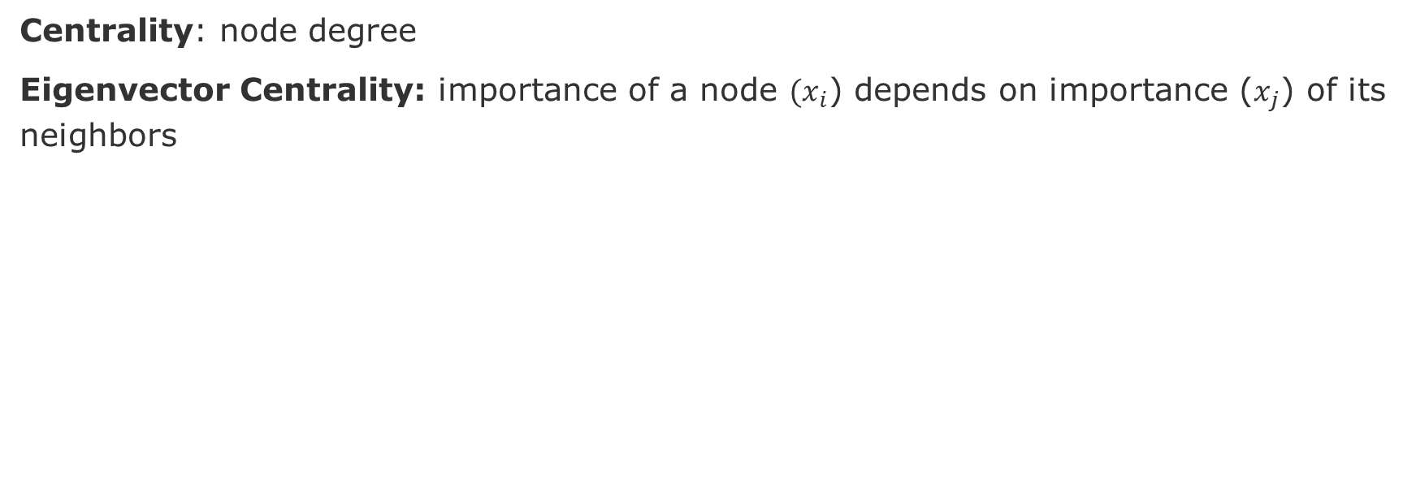
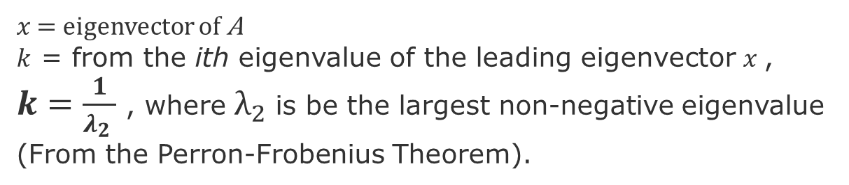
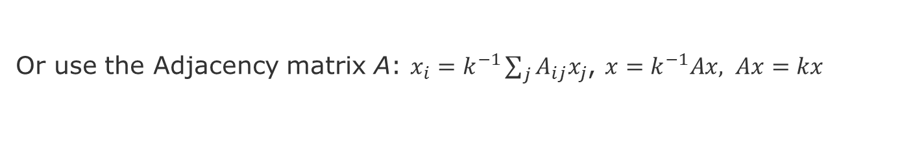
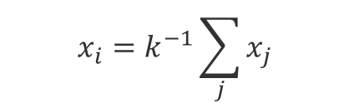
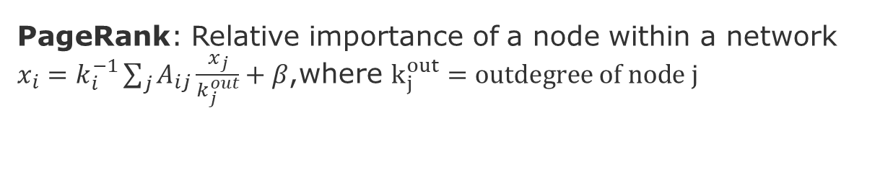
Centrality Metrics – Degree-based
Centrality: node degree
Eigenvector Centrality: importance of a node $(x_{i}$) depends on importance ($x_{j}$) of its neighbors
source: Wikipedia
$$x_{i}=k^{−1}\sum_{j}{x_{j}}$$
Or use the Adjacency matrix A: $x_{i}=k^{−1}\sum_{j}{A_{ij}x_{j}}$, $x=k^{−1}Ax, Ax=kx$
$x$ = eigenvector of A
$k$ = from the ith eigenvalue of the leading eigenvector $x$, $k=\frac{1}{λ_{2} }$ , where $λ_{2}$is be the largest non-negative eigenvalue (From the Perron-Frobenius Theorem).
Katz Centrality: Relative degree of influence of a node within a network
$x_{i}=k^{−1}\sum_{j}{A_{ij}x_{j}}+β$,where $β=constant$
PageRank: Relative importance of a node within a network
$x_{i}=k_{i}^{−1}\sum_{j}{A_{ij}\frac{x_{j}}{k_{j}^{out}}}+β$,where $k_{j}^{out}=outdegree of node j$
Newman, Mark. Networks. Oxford university press, 2018.
Borgatti, Stephen P., and Martin G. Everett. "A graph-theoretic perspective on centrality." Social networks 28.4 (2006): 466-484.
Notes:
Caveats of Eigenvector centrality: nodes with outgoing edges only will have centrality zero, acyclic graphs,
Caveat of Katz Centrality, Amazon pointing to many sellers
Grindrod, P., & Higham, D. J. (2010). Evolving graphs: dynamical models, inverse problems and propagation. Proceedings of the Royal Society A: Mathematical, Physical and Engineering Sciences, 466(2115), 753-770.

Slide 7
Centrality over Dynamically Evolving Networks (DEN)
Grindrod, P., & Higham, D. J. (2010). Evolving graphs: dynamical models, inverse problems and propagation. Proceedings of the Royal Society A: Mathematical, Physical and Engineering Sciences, 466(2115), 753-770.
Zhang, Xiao, et al., (2017). Random graph models for dynamic networks. The European Physical Journal B 90.10, pp.1-14.
Williams, Matthew J., and Mirco Musolesi. (2016). Spatio-temporal networks: reachability, centrality and robustness. Royal Society open science 3.6
Michail, Othon, et al., (2014). Causality, influence, and computation in possibly disconnected synchronous dynamic networks. Journal of Parallel and Distributed Computing 74.1 pp.2016-2026.
…
How centrality over DENs could help express the phenomena of information spreading - spread of disease, the broadcast of files on peer-to-peer networks, of rumors in social networks, and failure propagation in complex systems?
Notes:
Mertzios, George B., et al. "Computing maximum matchings in temporal graphs." arXiv preprint arXiv:1905.05304 (2019).
Molter, Hendrik. Classic graph problems made temporal–a parameterized complexity analysis. Technische Universitaet Berlin (Germany), 2020.
Smolyak, A., Levy, O., Vodenska, I., Buldyrev, S., & Havlin, S. (2020). Mitigation of cascading failures in complex networks. Scientific reports, 10(1), 1-12.

Slide 8
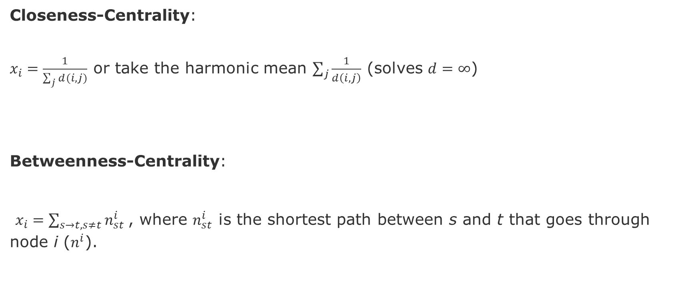
Centrality Metrics – Path-Based
source: Wikipedia
Closeness-Centrality:
$x_{i}=\frac{1}{\sum_{j}{d(i,j)}}$ or take the harmonic mean $\sum_{j}{\frac{1}{d\left(i,j\right)}}$ (solves $d=∞$)
Betweenness-Centrality:
$x_{i}=\sum_{s→t, s≠t}{n_{st}^{i}}$, where $n_{st}^{i}$ is the shortest path between s and t that goes through node i ($n^{i}$).
Newman, Mark. Networks. Oxford university press, 2018.
Borgatti, Stephen P., and Martin G. Everett. "A graph-theoretic perspective on centrality." Social networks 28.4 (2006): 466-484.

Slide 9
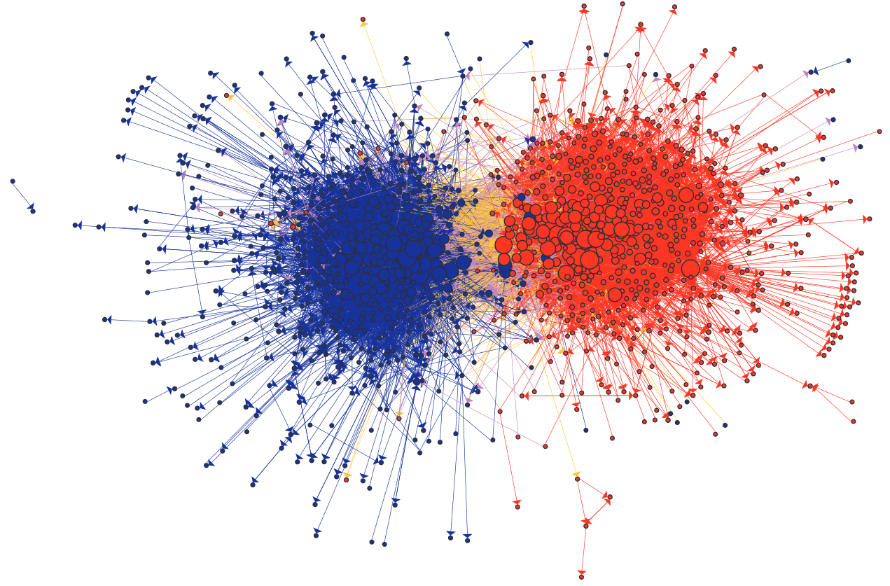
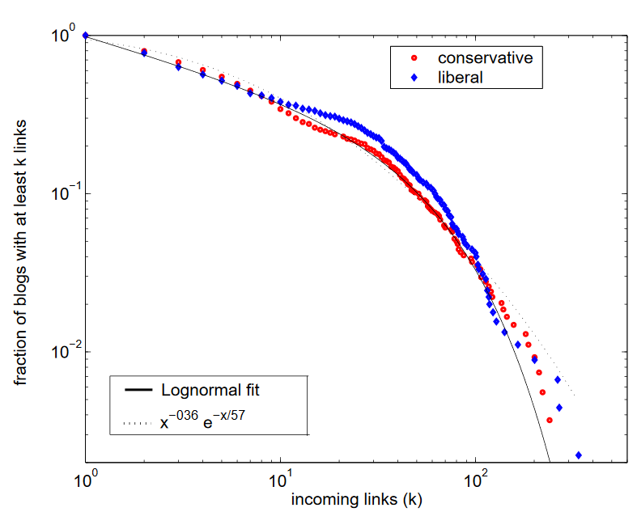
Political Blogosphere [Adamic & Glance 2005]
Cumulative distribution of incoming links for political blogs by category
Similar distributions can be fit with lognormal or exponential functions.
Larger blogs are more central
Homophily
Yellow links show blogs from opposite views commenting on each other
Source: Adamic, Lada A., and Natalie Glance. "The political blogosphere and the 2004 US election: divided they blog." Proceedings of the 3rd international workshop on Link discovery. 2005.
Notes:
The lack of overlap in lib-
eral and conservative interests has previously been observed
in purchases of political books on Amazon.com [8]. This
brings about the question of whether we are witnessing a
cyberbalkanization [11, 13] of the Internet, where the prolif-
eration of specialized online news sources allows people with
different political leanings to be exposed only to information
in agreement with their previously held views.
liberal and conservative
blogs did indeed have different lists of favorite news sources, people, and topics to discuss, although they occasionally
overlapped in their discussion of news articles and events.
The division between liberals and conservatives was further
reflected in the linking pattern between the blogs, with a
great majority of the links remaining internal to either lib-
eral or conservative communities.

Slide 10
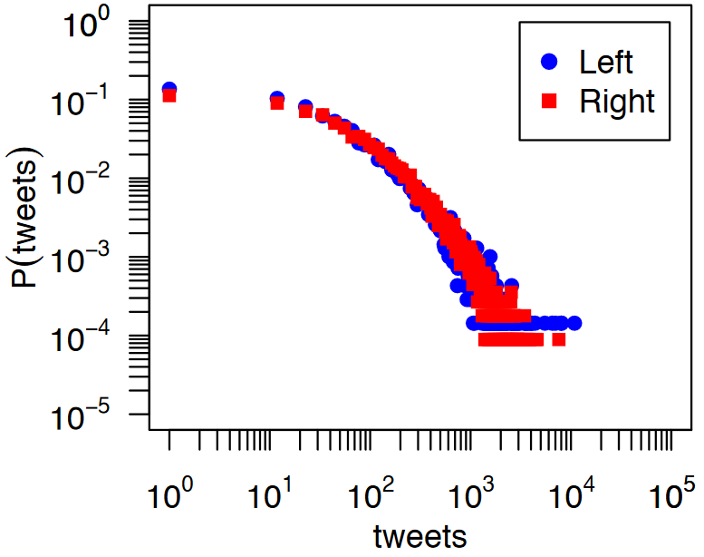
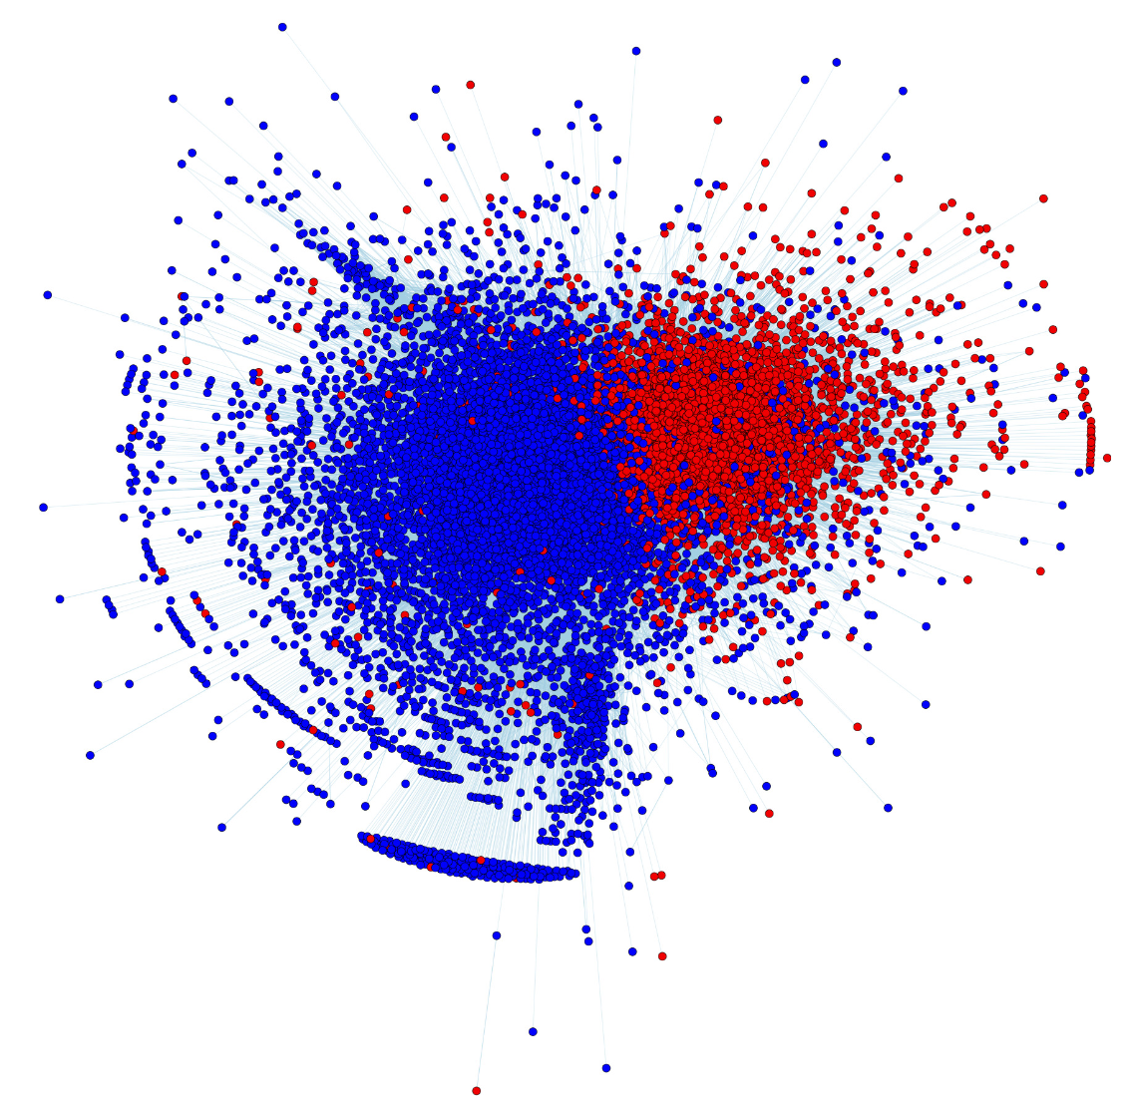
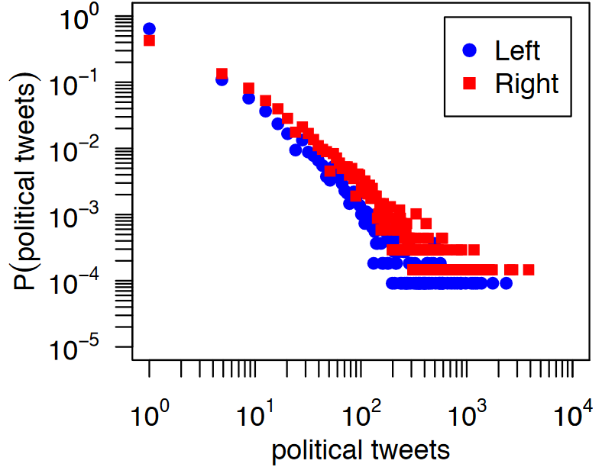
Partisan Asymmetries in Twitter [Conover et al. 2012]
Both groups produce same amount of tweets per capita
tweets = number of tweets a user posts
P(tweets) probability of a user
Right-leaning produce 2x more political content
One or more political hash tags
Right-leaning= 22% of tweets
Left-leaning= 12% of tweets
source: Conover, Michael D., et al. "Partisan asymmetries in online political activity." EPJ Data Science 1.1 (2012): 6.
Notes:
right-leaning users were almost twice as likely to create political content, with22%of all tweets produced by right-leaning userscontaining one or more of the political hashtags under study, compared to only12%for left-leaning users.

Slide 11
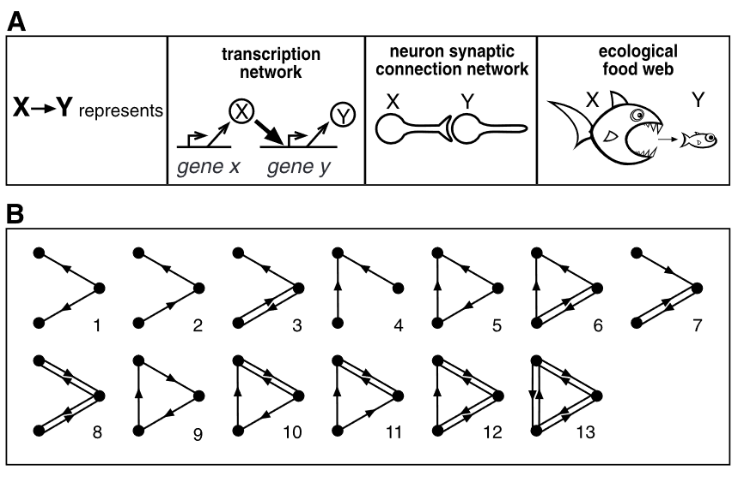
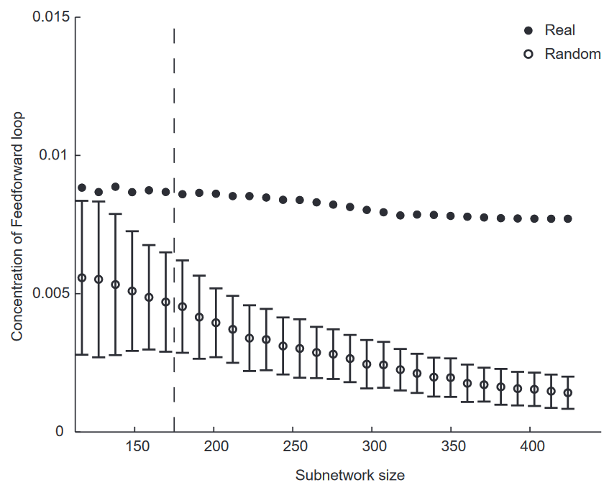
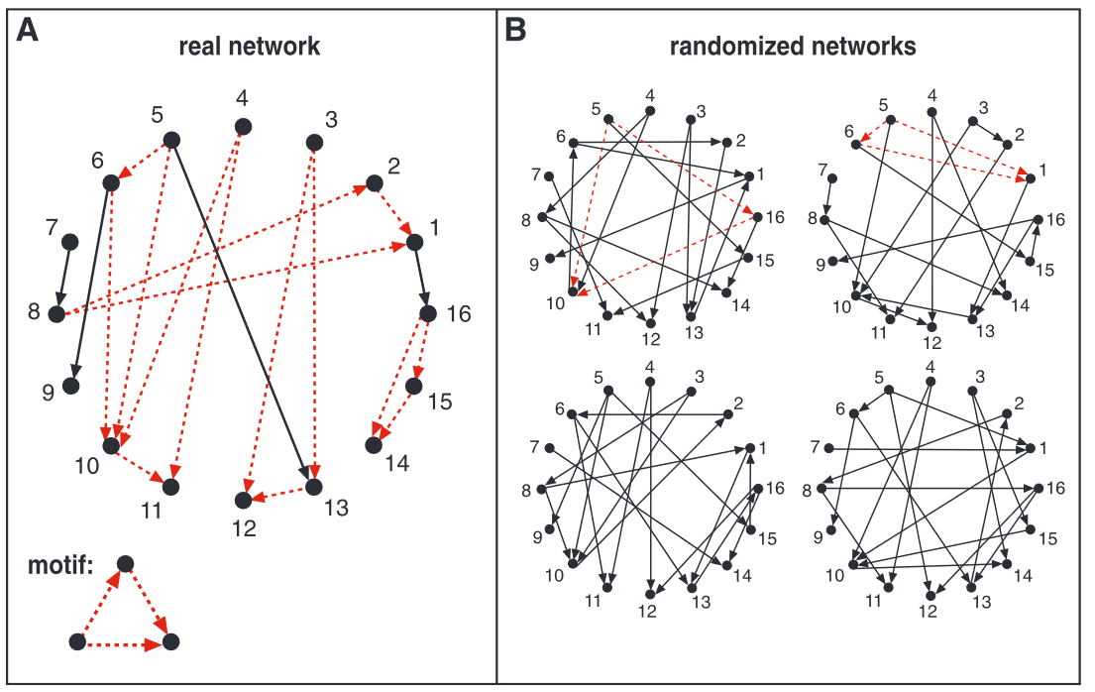
Motifs [Milo 2002]
Remarks
Number of motifs grow exponentially with the number of edges
Real networks tend to be rich in motifs, whereas Random networks not.
As Real networks evolve, their motif count remains stable, whereas in Random networks, it colapses.
This might suggest that motifs provide struture to the proper functioning of these networks
[Milo 2002] Milo, R. et al. Network motifs: Simple building blocks of complex networks. Science 298, 824–827 (2002).

Slide 12
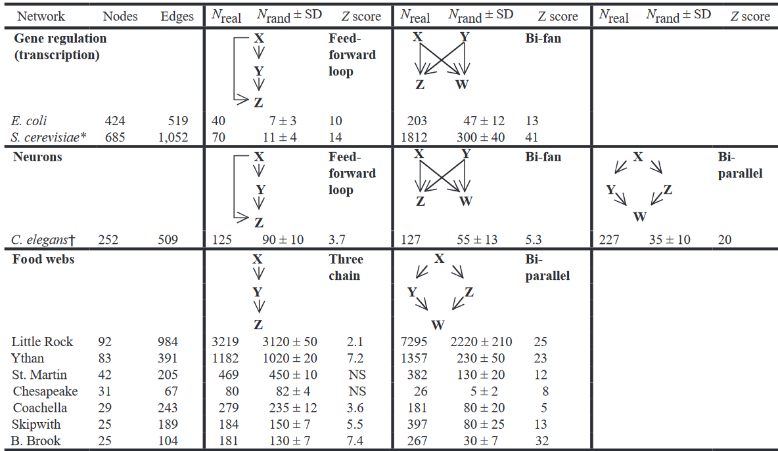
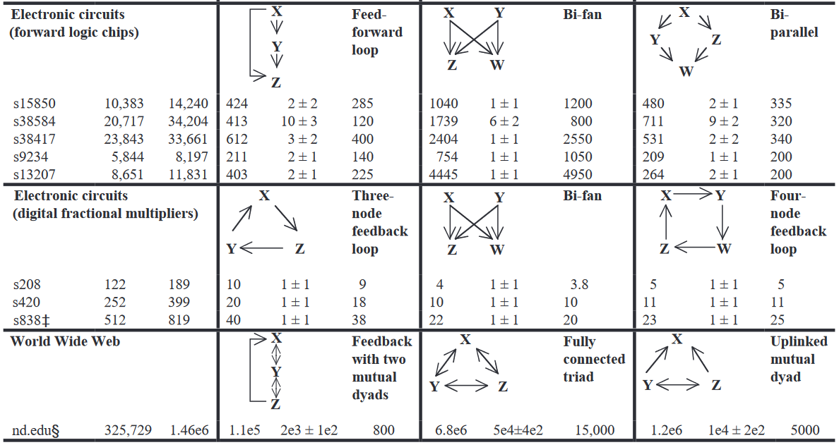
Motifs in real networks
Biological
Technological
Milo, R. et al. Network motifs: Simple building blocks of complex networks. Science 298, 824–827 (2002).

Slide 13
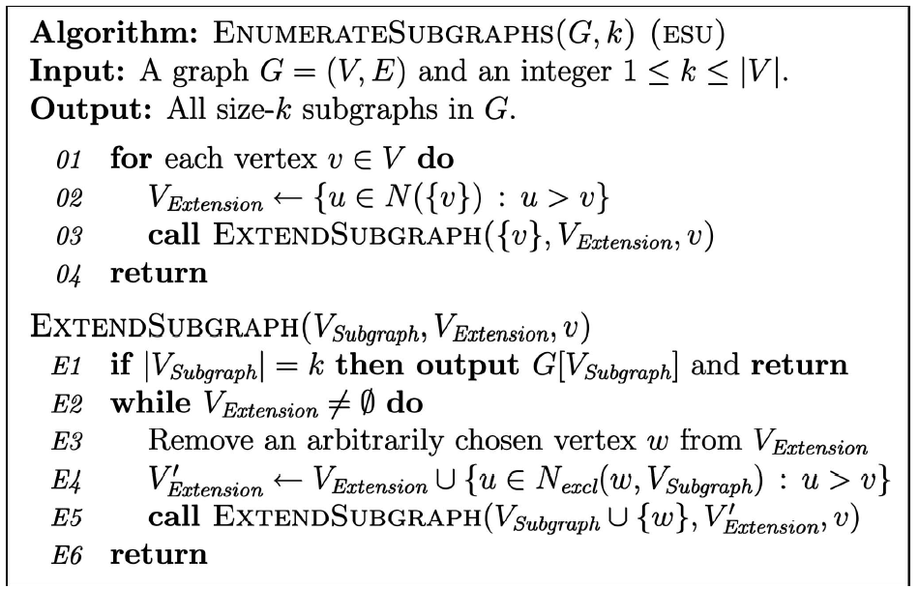
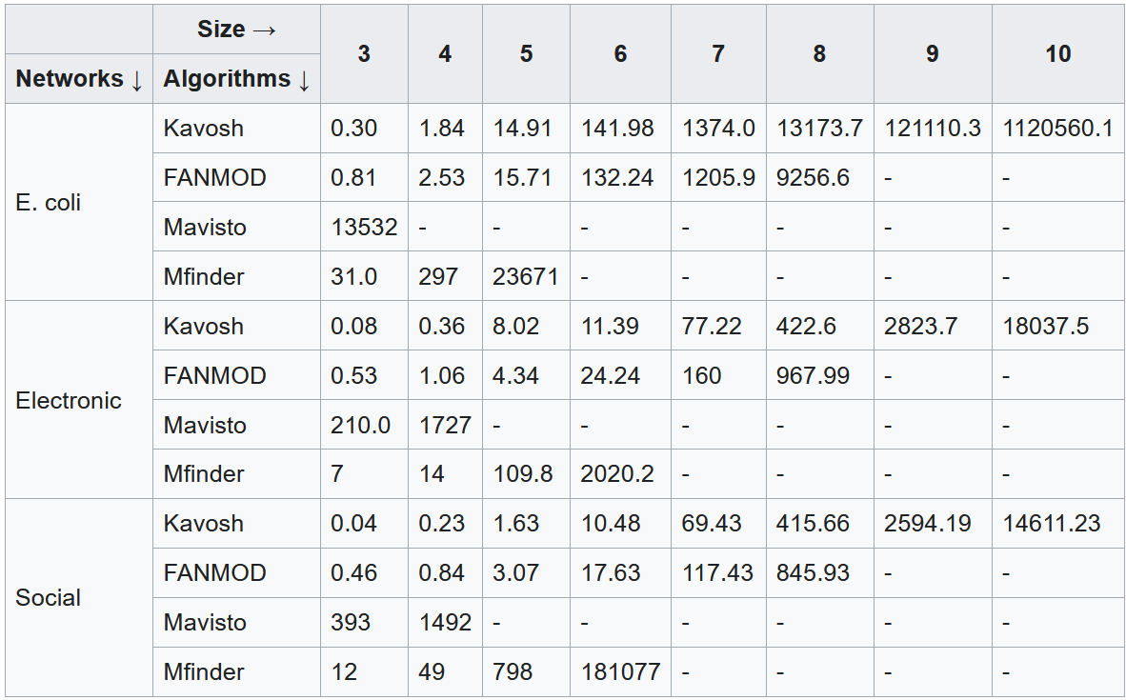
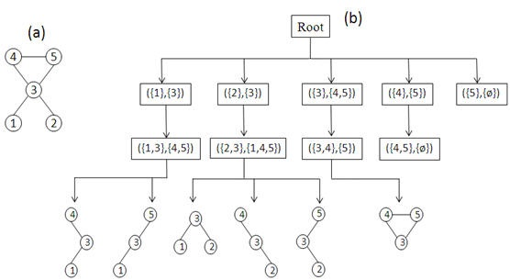
Motif counting – ESU (FANMOD) algorithm [Wernicke 2006]
EXT set of all the nodes that :
are adjacent to at least one of the nodes in SUB (guarantees expansion is a connected graph)
their numerical labels must be larger than the label of first element in SUB. (guarantees termination)
Many other algorithms have bee developed and tested
[Wernicke 2006] Wernicke S (2006). "Efficient detection of network motifs". IEEE/ACM Transactions on Computational Biology and Bioinformatics. 3 (4): 347–359.
Author: CC BY-SA 3.0, https://en.wikipedia.org/w/index.php?curid=36822191
https://en.wikipedia.org/wiki/Network_motif#Motif_discovery_algorithms
Notes:
FANMOD == ESU

Slide 14
Motif caveats
Caveats
Stability of a network structure not necessary imply function stability [Igram et al. 2006]
Network structure not always imply function [Voigt et al. 2005]
Static analysis might hide the relationship between structure and function
Temporal network motifs have been investigated [Braha & Bar-Yam 2009][Holme & Saramäki 2012]
[Braha & Bar-Yam 2009] Braha D., Bar-Yam Y. (2009). “Time-Dependent Complex Networks: Dynamic Centrality, Dynamic Motifs, and Cycles of Social Interactions.” In: Gross T., Sayama H. (eds) Adaptive Networks. Understanding Complex Systems. Springer, Berlin, Heidelberg
[Holme & Saramäki 2012] Holme, P., & Saramäki, J. (2012). Temporal networks. Physics reports, 519(3), 97-125.
[Ingram et al. 2006] Ingram PJ, Stumpf MP, Stark J (2006). "Network motifs: structure does not determine function". BMC Genomics. 7: 108.
[Voigt et al. 2005] Voigt CA, Wolf DM, Arkin AP (2005). "The Bacillus subtilis sin operon: an evolvable network motif". Genetics. 169 (3): 1187–202.

Slide 15
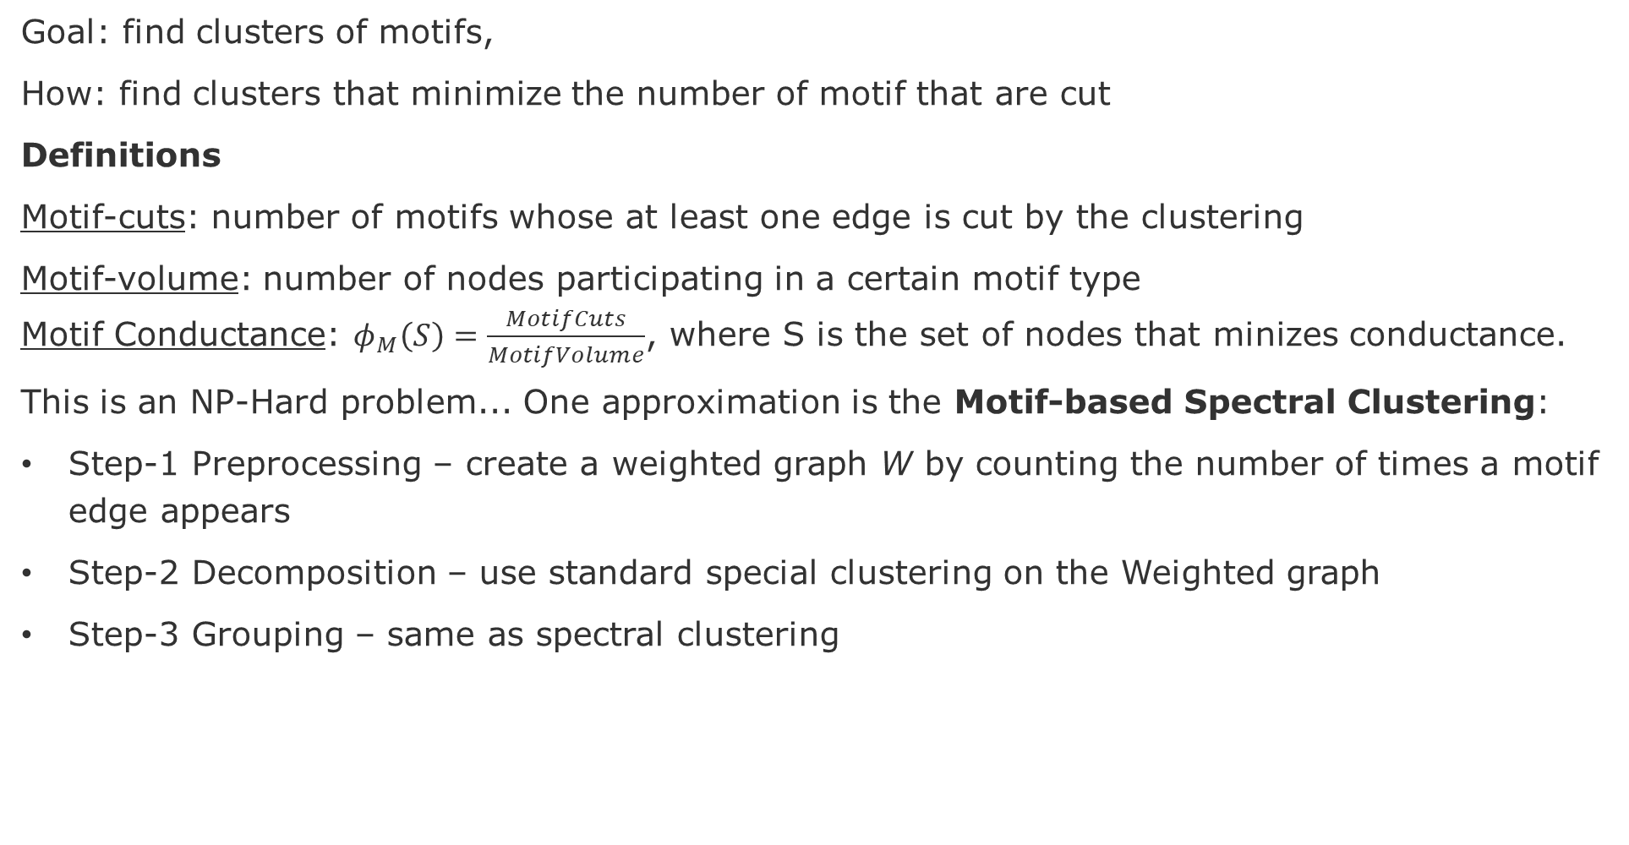
Motif-based spectral clustering
Goal: find clusters of motifs,
How: find clusters that minimize the number of motif that are cut
Definitions
Motif-cuts: number of motifs whose at least one edge is cut by the clustering
Motif-volume: number of nodes participating in a certain motif type
Motif Conductance: $φ_{M}\left(S\right)=\frac{MotifCuts}{MotifVolume}$, where S is the set of nodes that minizes conductance.
This is an NP-Hard problem... One approximation is the Motif-based Spectral Clustering:
Step-1 Preprocessing – create a weighted graph W by counting the number of times a motif edge appears
Step-2 Decomposition – use standard special clustering on the Weighted graph
Step-3 Grouping – same as spectral clustering
Lu, Zhenqi, Johan Wahlström, and Arye Nehorai. "Community detection in complex networks via clique conductance." Scientific reports 8.1 (2018): 1-16.
Notes:
Lu, Zhenqi, Johan Wahlström, and Arye Nehorai. "Community detection in complex networks via clique conductance." Scientific reports 8.1 (2018): 1-16.

Slide 16
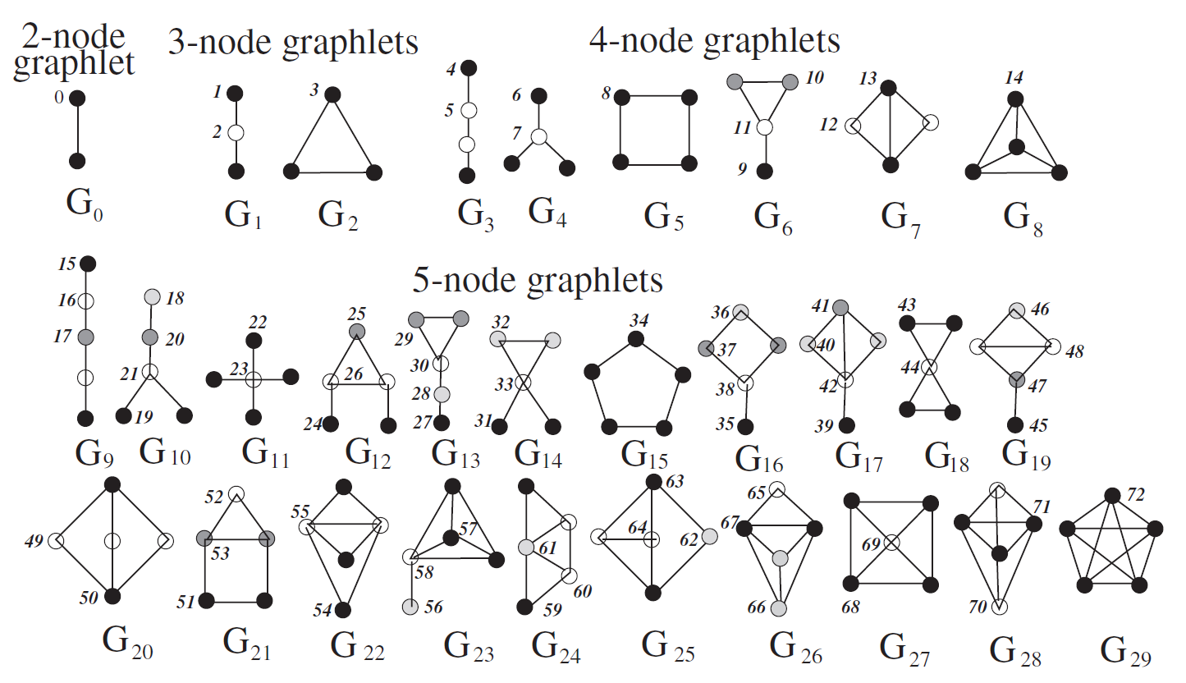
Graphlets
Automorphism orbits 0,1,2, . . . , 72 for the thirty 2, 3, 4, and 5-node graphlets G0,G1, . . . ,G29. In a graphlet Gi, i 2 {0,1,. . .29}, nodes belonging to
the same orbit are of the same shade
source: Pržulj, N., Biological network comparison using graphlet degree distribution, Bioinformatics, 23, 2, 2007, pp, e177–e183

Slide 17
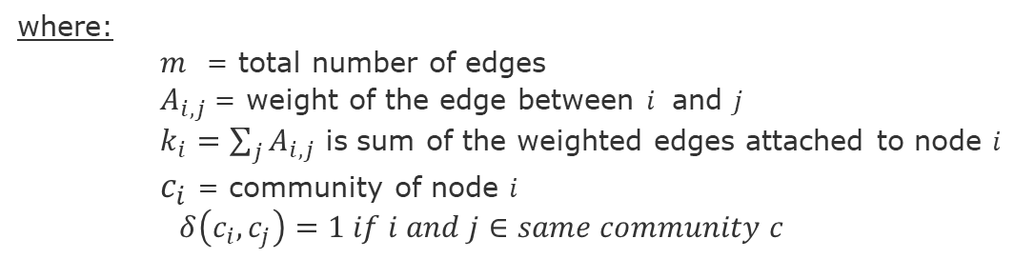
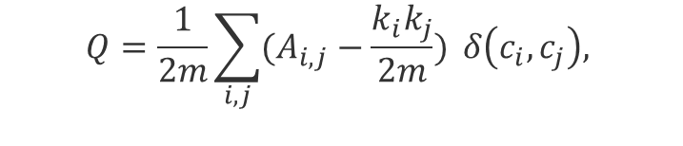
Modularity (Q) – quality of clustering
Modularity (Q) fraction of the edges within the given groups minus the expected such fraction if edges were distributed at random. It is defined as [Newman 2004]:
Actual connection between i and j
$$Q=\frac{1}{2m}\sum_{i,j}{(A_{i,j}−\frac{k_{i}k_{j}}{2m})} δ\left(c_{i},c_{j}\right),$$
If nodes were randomly connected
(null model)
where:
$m$ = total number of edges
$A_{i,j}$= weight of the edge between $i$ and $j$
$k_{i}=\sum_{j}{A_{i,j}}$ is sum of the weighted edges attached to node $i$
$c_{i}$ = community of node $i$
$δ\left(c_{i},c_{j}\right)=1 if i and j∈same community c$
[Newman 2004] Newman, Mark EJ. "Analysis of weighted networks." Physical review E 70.5 (2004): 056131.
[Blondel et al. 2008] Blondel, Vincent D., et al. (2008), "Fast unfolding of communities in large networks.“, Journal of statistical mechanics: theory and experiment, 2008(9), pp.1-13.

Slide 18
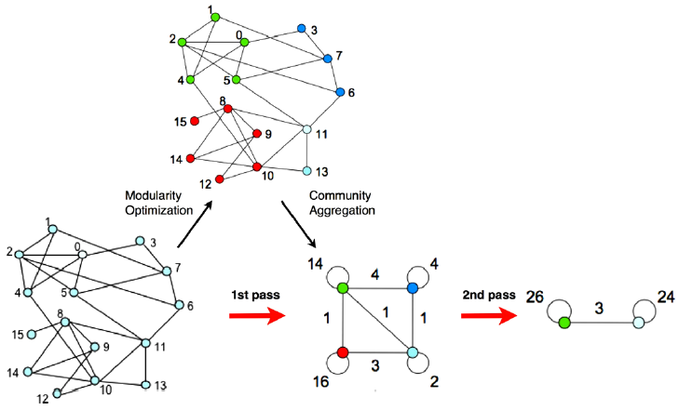
Louvain Algorithm
Iterate until find the lowest modularity value

Slide 19
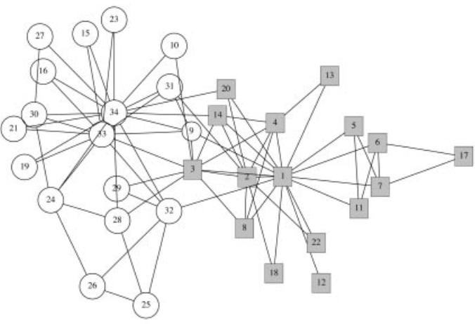
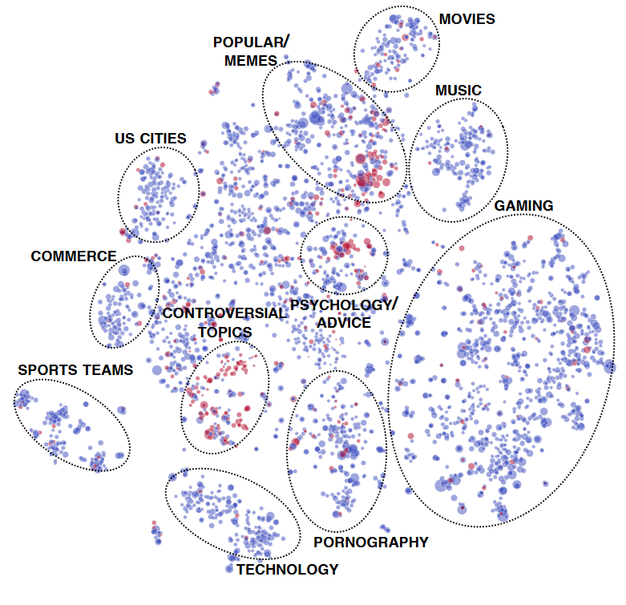
Community structure
Zachary’s Karate Club Split [Girvan et al. 2002]
Reddit Communities [Kumar, et al. 2018]
Instructor group
Club Admin group
[Girvan et al. 2002] Girvan, Michelle, and Mark EJ Newman. "Community structure in social and biological networks." Proceedings of the national academy of sciences 99.12 (2002): 7821-7826.
[Kumar et al. 2018] Kumar, S., Hamilton, W. L., Leskovec, J., & Jurafsky, D. (2018, April). Community interaction and conflict on the web. In Proceedings of the 2018 World Wide Web Conference (pp. 933-943).
Notes:
[Newman 2002] Newman, M. E. J. (2003). "Mixing patterns in networks". Physical Review E. American Physical Society (APS). 67 (2):

Slide 20
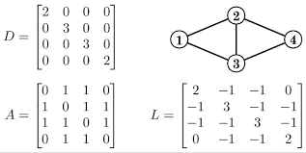
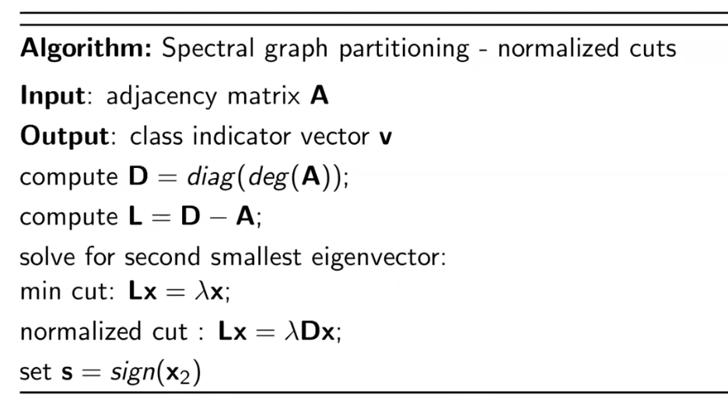
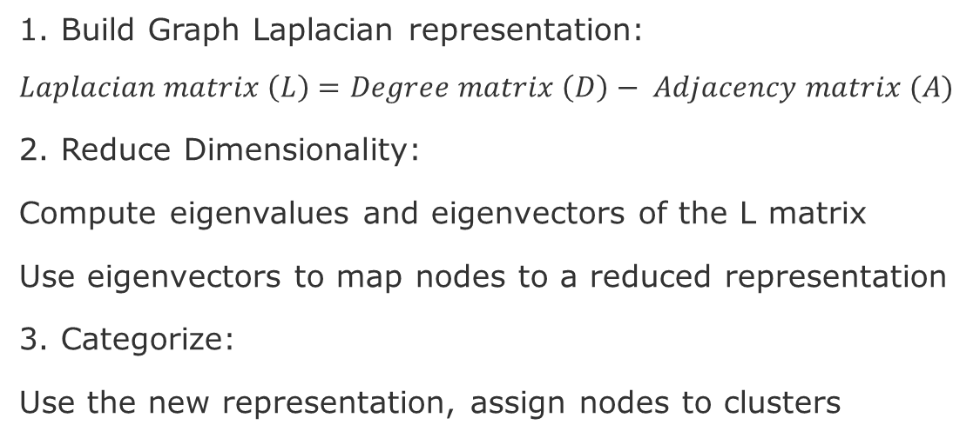
Spectral Clustering
1. Build Graph Laplacian representation:
$$Laplacian matrix \left(L\right)=Degree matrix \left(D\right)− Adjacency matrix (A)$$
2. Reduce Dimensionality:
Compute eigenvalues and eigenvectors of the L matrix
Use eigenvectors to map nodes to a reduced representation
3. Categorize:
Use the new representation, assign nodes to clusters
L = D-A
Further resources
Short Tutorial on Graph Laplacian: https://csustan.csustan.edu/~tom/Clustering/GraphLaplacian-tutorial.pdf
Lecture Slides: http://graphics.stanford.edu/courses/cs468-10-fall/LectureSlides/16_spectral_methods1.pdf
Tutorial on Spectral Clustering: nhttps://www.cs.cmu.edu/~aarti/Class/10701/readings/Luxburg06_TR.pdf

Slide 21
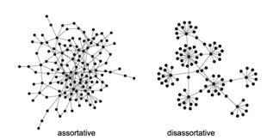
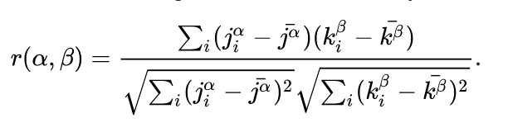
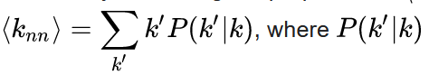
Homophily metrics
Definition: Preference to attach to nodes that are similar [Newman 2003]
Assortativity Coefficient (Pearson Correlation r) in a Directed Graph can be computed as r(in,in), r(in,out), r(out,out), r(out,in) [Newman 2002]
, where α,β are any a pair in/out, $j_{i}^{α}$ is the alpha degree of the source node (tail of the edge i), $k_{i}^{β}$ is the beta-degree of the target (head node of the edge i). The symbols with bar are the average.
Neighborhood Connectivity [Pastor Satorras 2001]
, where P(k’|k) is the conditional probability that an edge of a node with degree K points to a node with degree k’.
Newman, M. E. J. (2003). Mixing patterns in networks. Physical Review E. American Physical Society (APS). 67 (2):026126
Newman, M. E. J. (2002). Assortative Mixing in Networks. Physical Review Letters. 89 (20): 208701
Pastor-Satorras, Romualdo, et al., (2001). Dynamical and Correlation Properties of the Internet. Physical Review Letters. 87 (25): 258701
For various models of computing Assortative, look at:
Melamed, D., et al., (2018). Cooperation, clustering, and assortative mixing in dynamic networks. PNAS, 115(5), 951-956.
Notes:
[Pastor Satorras 2001] Pastor-Satorras, Romualdo, et al., 2001, Dynamical and Correlation Properties of the Internet. Physical Review Letters. 87 (25): 258701

Slide 22

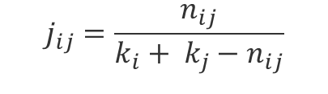
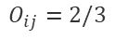
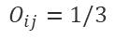
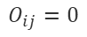
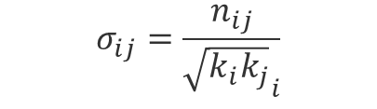
Node equivalence
$$j_{ij}=\frac{n_{ij}}{k_{i}+ k_{j}−n_{ij}}$$
Structural equivalence
Jaccard Similarity (intersection)
Cosine Similarity (distance)
Pearson Correlation
Euclidean Distance (dissimilarity)
Node overlap
Regular equivalence
Nodes that do not necessarily share neighbors, but have similar features
$$σ_{ij}=\frac{n_{ij}}{{\sqrt{k_{i}k_{j}}}_{i}}$$
$$O_{i,j}= \frac{| (N_{i}⋂N_{j})\backslash \{i,j\}|}{|(N_{i}⋃N_{j})\backslash \{i,j\}|}$$
i
j
i
j
i
j
$$O_{ij}=0$$
$$O_{ij}=1/3$$
$$O_{ij}=2/3$$

Slide 23
Next Tasks
Initial understanding about the graph data
What are possible the edges and nodes of the network?
What types of networks w.r.t. edge directionality?
What type of networks w.r.t. to node types?
Is your network possibly assortative, dissortative, or neither?
Which centrality metrics might make sense?
Are there communities/clusters that can be used as features?
Do you believe your graph will present high or low cluster coefficient?
What about the network diameter (low or high)?

Slide 24
END

